Slide 1
Selection Control Structure
Chapter 4

Slide 2
Algorithm
Before writing a program to solve a particular problem, we must have a thorough understanding of the problem and a carefully planned solution.
Algorithm: solving a problem by:
  Specifying the actions to be executed.
  Specifying the order in which these actions are to be executed.

Slide 3
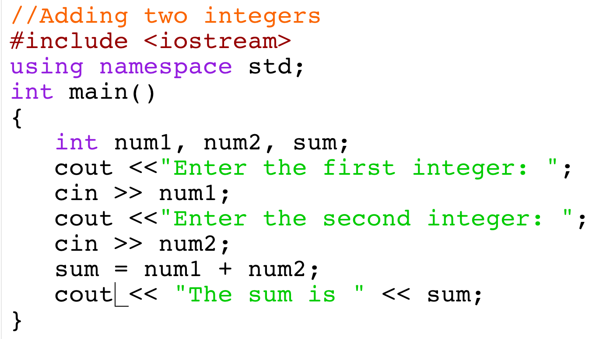
Algorithm: example
Write a program that reads two numbers from user and prints their sum.
Algorithm:
Get the values of two numbers from the user.
Add the two numbers.
Store the result.
Print the result.

Slide 4
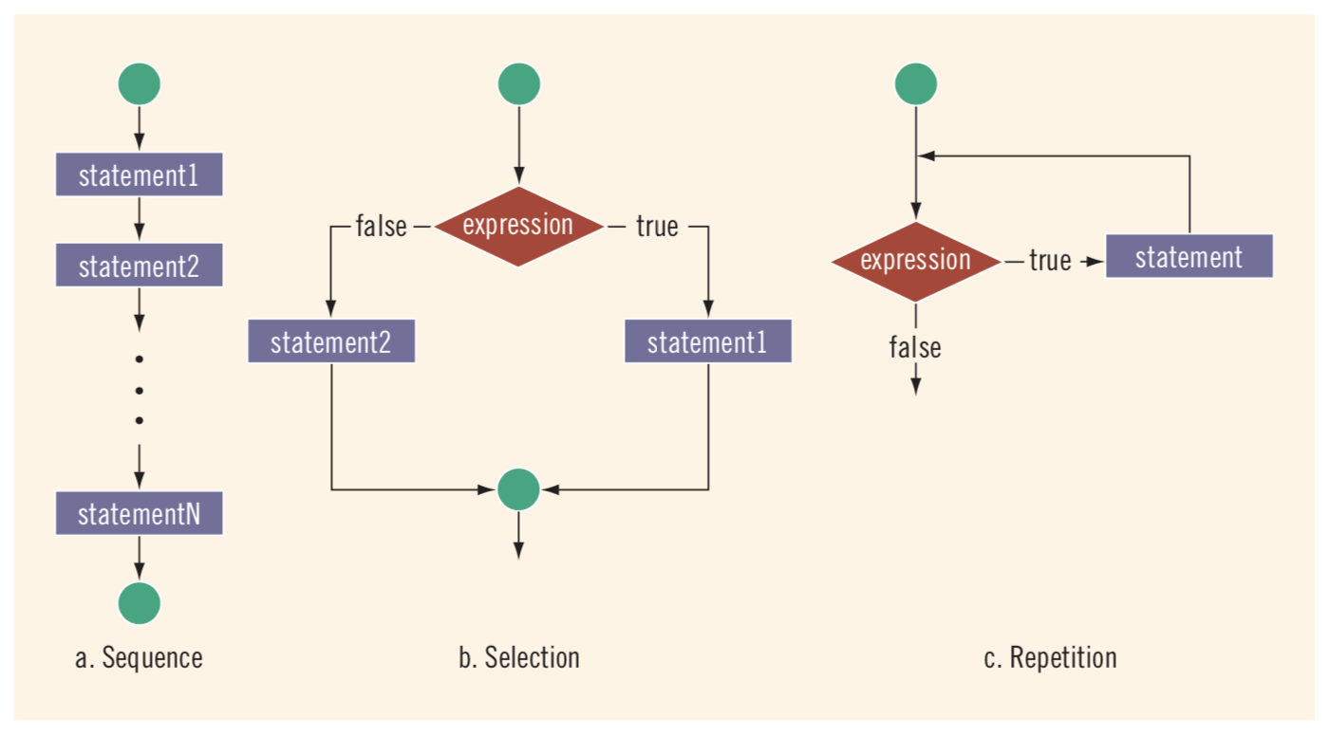
Flow of execution

Slide 5
Control Structure
All the examples we studied till now starts at the beginning and follows the statements in order (in a “sequential” way).
Control structures: Control the flow of execution in a program and provide alternatives to sequential program.
Two control structure are essential in C++:
  The selection control (decision making)
  The repetition control

Slide 6
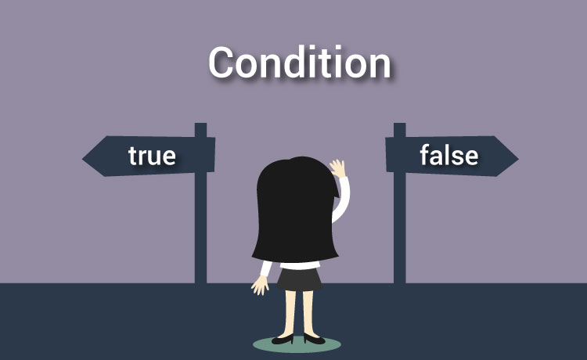
Decision making
We might make a decision in a program, for example, to determine whether a person’s grade on an exam is greater than or equal to 60 and whether the program should print the message “Congratulations! You passed.”
A program makes a decision based on the truth or falsity of a statement of fact called a condition.

Slide 7
Conditional Statement: examples
Certain statements are executed only if the condition evaluates to true.
if (score is greater than or equal to 90) → grade is A
if (hours worked are less than or equal to 40) → salary = hours * 500
Otherwise → salary = hours * 500 + 1500
if (temperature is less than 30 degrees and it is not raining) → Have picnic!!

Slide 8
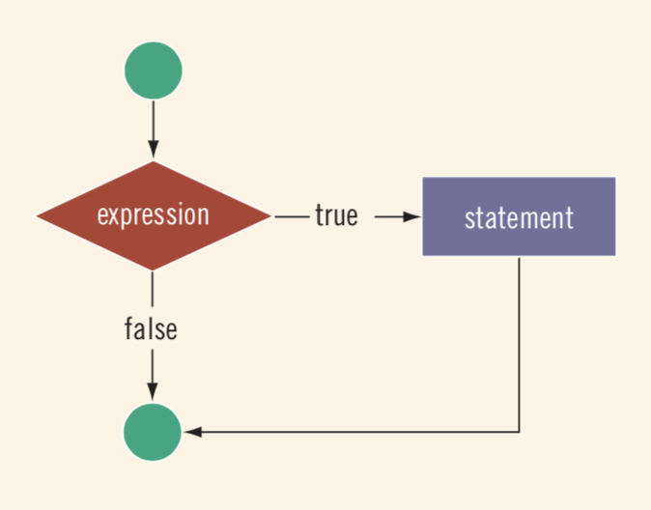
One way selection: if statement
Syntax of one-way selection using if statement:
One statement:
Block of statements:
Where expression is a condition formed using equality operators (==, !=) and relational operators (<, <=, >, >=) and may connect them with logical operators (&&, ||).
if (expression)
statement;
No semicolon
if (expression)
{
statement1;
statement2;
…
}

Slide 9
One way selection: if statement
If the value of the expression is true, the statement executes.
If the value is false, the statement does not execute and the computer goes on to the next statement in the program.
Example:
if (score >= 60) if (score >= 60) {
grade = 'P'; grade = 'P';
cout << “Pass”; }

Slide 10
One way selection: if statement
Single statement
Block of statements
int main()
{
…
if (expression)
Statement1;
Statement2;
Statement3;
…
}
int main()
{
…
…
if (expression) {
Statement1;
Statement2;
}
Statement3
…
}

Slide 11
One way selection: Example1
Write a program that reads an exam grade from user and prints the message “Congratulations! You passed.” if the grade is greater than or equal to 60.
First step: Algorithm
Get the exam grade from the user. Check if the grade is greater than or equal to 60. If the grade is greater than or equal to 60, print the “congratulations” message. If the grade is less than 60 do nothing.

Slide 12
One way selection: Example1
Second step: Translate algorithm to coding
#include <iostream> using namespace std; int main() { } // end main
First step: Algorithm
Get the exam grade from the user. Check if the grade is greater than or equal to 60. If the grade is greater than or equal to 60, print the “congratulations” message. If the grade is less than 60 do nothing.
int grade;
cout << “Enter the exam grade: ”;
cin >> grade;
if (grade >= 60)
cout << “Congratulations! You passed.”;

Slide 13
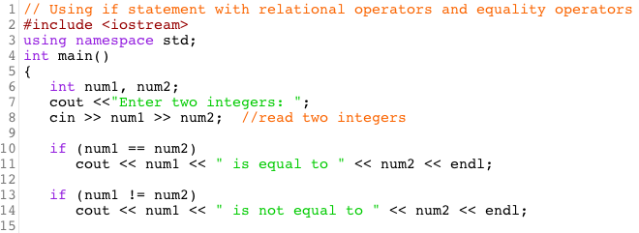
One way selection: Example2
Write a program that reads two numbers from user and prints the relationship they satisfy.

Slide 14
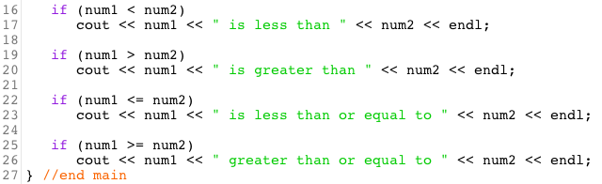
One way selection: Example2 (cont.)

Slide 15



One way selection: Example2 (cont.)
Sample Output

Slide 16
One way selection: Example2 (cont.)
if ( num1 == num2 )
cout << num1 << “ is equal to “” << num2 << endl;
  compares the values of the variables num1 and num2 to test for equality:
  If the values are equal, the statement in line 11 displays a line of text indicating that the numbers are equal.
  If the conditions are true in one or more of the if statements starting in lines 13, 16, 19, 22 and 25, the corresponding body statement displays an appropriate line of text.
  Indenting the body of each if statement and placing blank lines above and below each if statement enhances program readability.

Slide 17
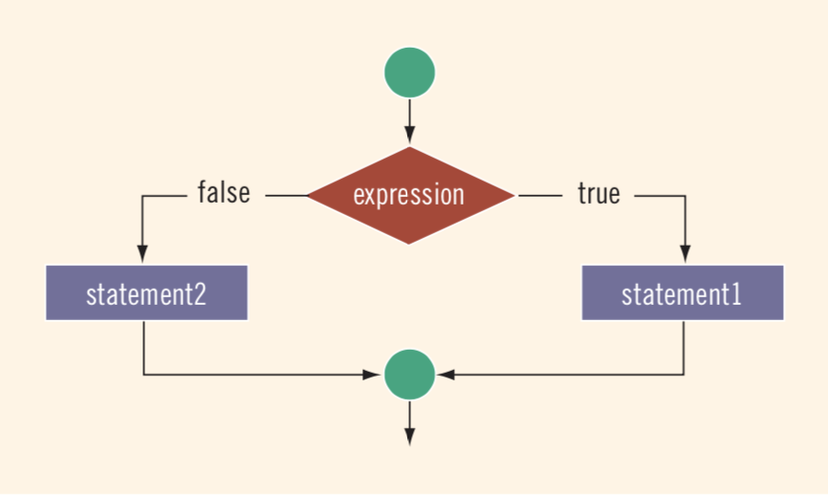
Two way selection: if else statement
The if else selection statement allows you to specify that different actions are to be performed when the condition is true and when it is false.
Syntax of two-way selection using if else statement:
If the value of the expression is true, statement1 executes.
If the value of the expression is false, statement2 executes.
if (expression)
{
block of statements1
}
else
{
block of statements2
}
other statements

Slide 18
Two way selection: Example
Write a program that prints “Passing” if student’s grade is greater than or equal to 60 and prints “Failing” otherwise.
The program should finally print a “Goodbye” message.
Algorithm
Get the exam grade from the user. Check if the grade is greater than or equal to 60. If the condition is true, print “Passing” message. If the condition is false, print “Failing” message. Print “Goodbye” message.

Slide 19
Two way selection: Example (cont.)
Code
#include <iostream> using namespace std; int main() {
Algorithm
Get the exam grade from the user. Check if the grade is greater than or equal to 60. If the condition is true, print “Passing” message. If the condition is false, print “Failing” message. Print “Goodbye” message.
int grade;
cout << “Enter the exam grade: ”;
cin >> grade;

Slide 20
Two way selection: Example (cont.)
Code
} //end main
if (grade >= 60)
Algorithm
Get the exam grade from the user. Check if the grade is greater than or equal to 60. If the condition is true, print “Passing” message. If the condition is false, print “Failing” message. Print “Goodbye” message.
cout << “Passing” << endl;
else
cout << “Failing” << endl;
cout << “Goodbye” << endl;

Slide 21
Multiple selection: Nested if
Used when some problems require the implementation of more than two alternatives.
Syntax:
if (expression 1)
statement 1;
else if (expression 2)
statement 2;
…
else if (expression 3)
statement 3;
else
statement n;

Slide 22
Multiple selection: Example
Write a program that outputs the letter grade of a student given his score.
Algorithm
Get the score from the user. Check if score is greater than or equal to 90. Condition true: output the letter grade ‘A’. Check if score is greater than or equal to 80. Condition true: output the letter grade ‘B’. Check if score is greater than or equal to 70. Condition true: output the letter grade ‘C’. Check if score is greater than or equal to 60. Condition true: output the letter grade ‘D’. Check if score is less than 60. Condition true: output the letter grade ‘F’.

Slide 23
Multiple selection: Example
Code
#include <iostream> using namespace std; int main() { int score; cout << “Enter the score: ”; cin >> score; if (score >= 90) cout << "The grade is A." << endl; else if (score >= 80) cout << "The grade is B." << endl; else if (score >= 70) cout << "The grade is C." << endl; else if (score >= 60) cout << "The grade is D." << endl; else if (score < 60) cout << "The grade is F." << endl; }

Slide 24
Examples on Different Cases
What is the output of the following segments supposing that x = 5?
if (x > 0) cout << "1"; cout << "2"; | if (x < 0) { cout << "1"; cout << "2"; } | if (x < 0) cout << "1"; cout << "2";
if (x > 0) { cout << "1"; cout << "2"; } | if (x > 0) cout << "1"; else cout << "2"; cout << "3"; | if (x < 0) { cout << "1"; if (x > 3) cout << "2"; } else cout << "3";
if (x > 0) cout << "1"; if (x < 3) cout << "2"; else cout << "3"; | if (x > 0) cout << "1"; else { cout << "2"; cout << "3"; }
12
2
12
13
3
13
1

Slide 25
If vs. if else
What is the different between these program segments supposing that score is 95?
In (1), the expression in the first if statement evaluates to true and the statement associated with it is then executed. The rest of the structure is skipped; and the remaining if statements are NOT evaluated.
In (2) the computer has to evaluate the expression in each if statement because there is no else statement.
WHAT IS THE OUTPUT OF EACH SEGEMENT?
if (score >= 90) cout << "The grade is A.”; else if (score >= 80) cout << "The grade is B."; else if (score >= 70) cout << "The grade is C."; else if (score >= 60) cout << "The grade is D."; else cout << "The grade is F."; | if (score >= 90) cout << "The grade is A.”; if (score >= 80) cout << "The grade is B."; if (score >= 70) cout << "The grade is C."; if (score >= 60) cout << "The grade is D."; if (score < 60) cout << "The grade is F.";
(1)
(2)

Slide 26
Conditional operator (? :)
Some if...else statements can be written using the conditional operator.
Syntax for using the conditional operator is:
It is ternary operator, which means that it takes three operands.
If conditionalExpression evaluates to a nonzero integer (i.e. to true), the result of the conditional expression is expression1. Otherwise, the result of the conditional expression is expression2.
conditionalExpression ? expression1 : expression2

Slide 27
Example 1
Convert the if else statement to a conditional expression.
#include <iostream>
using namespace std;
int main ()
{
int grade;
cout << "Enter grade: ";
cin >> grade;
if (grade >= 60)
cout << "Pass";
else
cout << "Fail";
return 0;
}
grade >= 60 ? cout << "Pass" : cout << "Fail";

Slide 28
Example 2
Using the conditional operator, write a program that reads two numbers and prints the maximum number.
#include <iostream>
using namespace std;
int main ()
{
int a, b, max;
cout << "Enter two integers: ";
cin >> a >> b;
// If condition (a >= b) is true, max = a
// If condition (a >= b) is false, max = b
max = (a >= b) ? a : b;
cout << "The maximum number is " << max;
return 0;
}
if (a >= b)
max = a;
else
max = b;

Slide 29

Multiple selection: Switch statement
Switch structure gives the computer the power to choose from many alternatives.
Unlike if else structure, it does not require the evaluation of a logical expression

Slide 30
Multiple selection: Switch statement
Syntax of switch statement:
Any expression that could be evaluated to int or char ONLY
switch (expression)
{
case value_1:
statements_1 ;
break;
case value_2:
statements_2;
break;
…
case value_n:
statements_n;
break;
default:
statements;
}

Slide 31
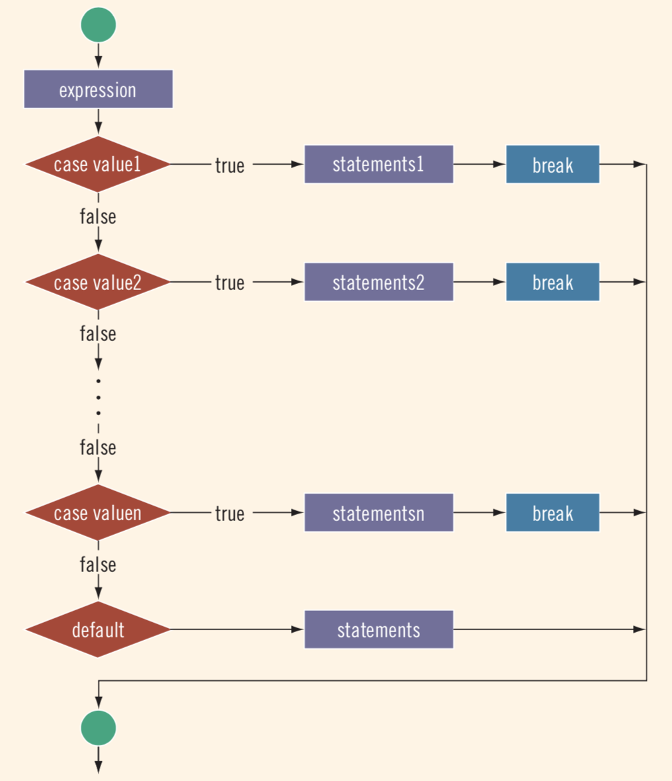
Multiple selection: Switch statement
If expression value match a case value, the statements execute until break is found or the end of the switch structure is reached.
If expression value does not match any case, the statements after default execute.
If the switch has no default and if the expression value does not match any case, the entire switch statement is skipped.
A break statement causes an immediate exit from the switch.

Slide 32
Switch statement : Example
Write a program that reads two integers from user. It then displays a menu of the arithmetic operators, calculates and prints the result based on user selection. The program should prompt the user in case of an invalid input.
The menu to be displayed is as follows:
  Enter your choice:
  ‘+’: add
  ‘*’: multiply
  ‘/’: divide

Slide 33
Switch statement : Example
Code
#include <iostream> using namespace std; int main () { int n1, n2, result; char op; cout << "Enter two numbers: "; cin >> n1 >> n2; cout << "\'+\': add" << endl << "\'*\': multiply" << endl <<"\'/\': divide" << endl; cin >> op;

Slide 34
Switch statement : Example
Code
switch (op) { case '+': result = n1 + n2; break; case '*': result = n1 * n2; break; case '/': result = n1 / n2; break; default: cout << "Invalid input!"; break; } cout << "Result is: " << result; }

Slide 35
Switch statement
Sometimes, the same actions are to be performed on two different values.
For example, suppose that a program prompts the user to enter the gender M for male and F for female. The same actions are to be executed when the user enter m or M for male. Similarly, The same actions are to be executed when the user enter f or F for female.
The switch statement will then be written as:
switch (gender)
{
case ‘M’: case ‘m’:
….
case ‘F’: case ‘f’:
….
}

